Slide 1
(Template) Insert Title
Product Type (Grocery, Dairy, Frozen, Bulk)
Maximum Delivered Unit Cost To Distributor (If cost is FOB, then freight must be estimated to arrive at what the distributor’s finished cost would be)
Maximum Unit Cost to WFM (maximum delivered unit cost from distributor + 8% Markup)
Suggested Retail Price
Gross Margin %
Promotional Support Program (Total allowance in form of % and frequency of support)
Demo Support Program (# of Stores / Frequency)
Exclusivity (None, 60, 90, Control Label)
Channel Strategy of Item (Conventional, Natural, Big Box Formats)
Manufacturer Launch Date (Month/Year)
Insert Picture(s)/Charts here
500K Limit
Three compelling reasons
Sustainability / Efficacy/ Packaging / Facts
Other attributes
Scannable Bar Code
Vendor Contact Information (Manufacturer Company, Name, Email, Phone)

Slide 2
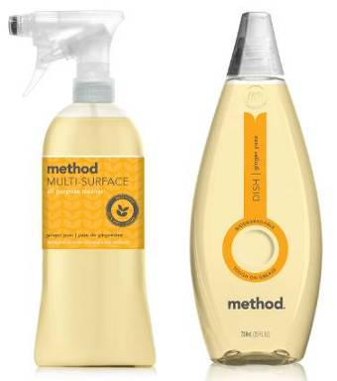
Method’s WFM Exclusive Line Extension
Grocery
$2.62 (Cost to Distributor = (FOB: $2.22 + Freight: $0.40 Freight)
$2.85 (Cost +8%)
$4.79 (SRP)
40.50% GM
20% Allowance / Quarterly
75 Demo’s / Quarterly (300 Demo’s Total)
90 Day Exclusive
90 Day Exclusive to WFM, followed by one year in Natural Channel, and then open to all channels.
January 2013
Example only ! Do not use this slide !
Multi Surface Cleaner and Dish Soap
Exclusive Ginger Yuzu Scent
Natural Colors – No Synthetic Dyes
Biodegradable
Bottles produced from 100% recycled plastic
Method : John Doe : john.doe@email.com : 555.555.555

